Slide 1

IBM Software Group
DB2 性能调优入门
Part 3: Applications(应用调优) Day 1
business on demand software
© 2008 IBM Corporation

Slide 2
议程
Day 1:
Explain工具
调优过程示例(Lab 3-1)
break
DB2的复杂SQL实践
  Lab(Lab3-2-SQL)
Day 2:
DB2的优化器
  Lab(Lab3-3-index,Lab3-3-Join,Lab3-3-stats)
break
其它DB2的优化技术
  Lab(Lab3-4-Other)

Slide 3
DB2 Explain工具
db2explain(文本)
db2expln –d –f <input_sql> -z ; -f –g
db2exfmt(文本)
db2exfmt -d tp1 -w -1 -n % -s % -# 0 -o exfmt.out
Visual explain(图形)
Notes:
Warehouse tasks
Creating a data warehouse involves the following tasks:
Identifying the source data (or operational data) and defining it for use as warehouse sources.
Creating a database to use as the warehouse and defining warehouse targets.
Defining a subject area for groups of processes that you will define in your warehouse.
Specifying how to move and transform the source data into its format for the warehouse database by defining steps in the processes.
Testing the steps that you define and scheduling them to run automatically.
Administering the warehouse by defining security and monitoring database usage using the Work in Progress notebook.
If you have DB2 ® Warehouse Manager, creating an information catalog of the data in the warehouse. An information catalog is a database that contains business metadata. Business metadata helps users identify and locate data and information available to them in the organization. Data
Warehouse Metadata can be published to the information catalog. The information catalog can be searched to determine what data is available in the warehouse.
Defining a star schema model for the data in the warehouse. A star schema is a specialized design that consists of multiple dimension tables, which describe aspects of a business, and one fact table, which contains the facts or measurements about the business. For example, for a manufacturing company, some dimension tables are products, markets, and time. The fact table contains transaction information about the products that are ordered in each region by season.

Slide 4
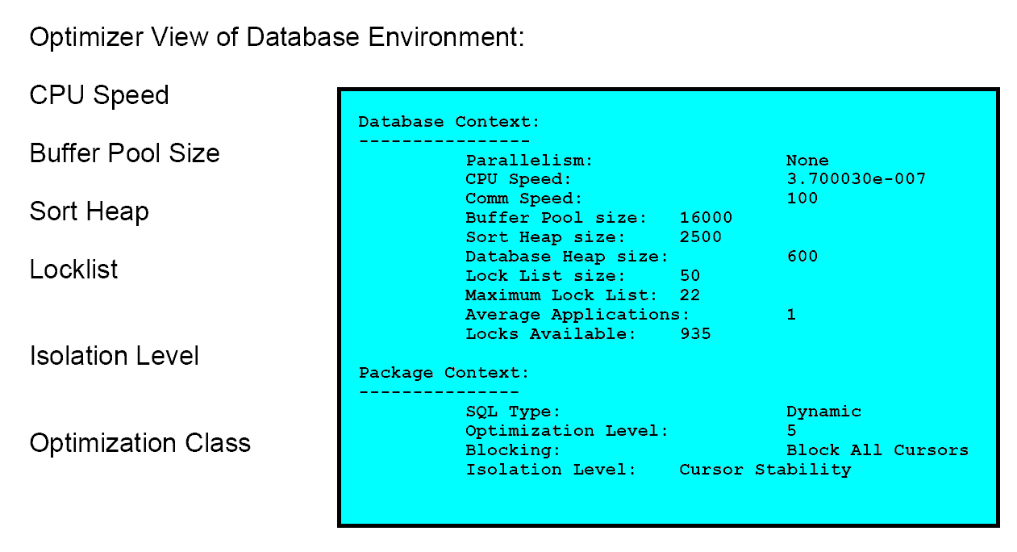
DB2 的执行计划(db2exfmt的输出)
Notes:
Warehouse tasks
Creating a data warehouse involves the following tasks:
Identifying the source data (or operational data) and defining it for use as warehouse sources.
Creating a database to use as the warehouse and defining warehouse targets.
Defining a subject area for groups of processes that you will define in your warehouse.
Specifying how to move and transform the source data into its format for the warehouse database by defining steps in the processes.
Testing the steps that you define and scheduling them to run automatically.
Administering the warehouse by defining security and monitoring database usage using the Work in Progress notebook.
If you have DB2 ® Warehouse Manager, creating an information catalog of the data in the warehouse. An information catalog is a database that contains business metadata. Business metadata helps users identify and locate data and information available to them in the organization. Data
Warehouse Metadata can be published to the information catalog. The information catalog can be searched to determine what data is available in the warehouse.
Defining a star schema model for the data in the warehouse. A star schema is a specialized design that consists of multiple dimension tables, which describe aspects of a business, and one fact table, which contains the facts or measurements about the business. For example, for a manufacturing company, some dimension tables are products, markets, and time. The fact table contains transaction information about the products that are ordered in each region by season.

Slide 5
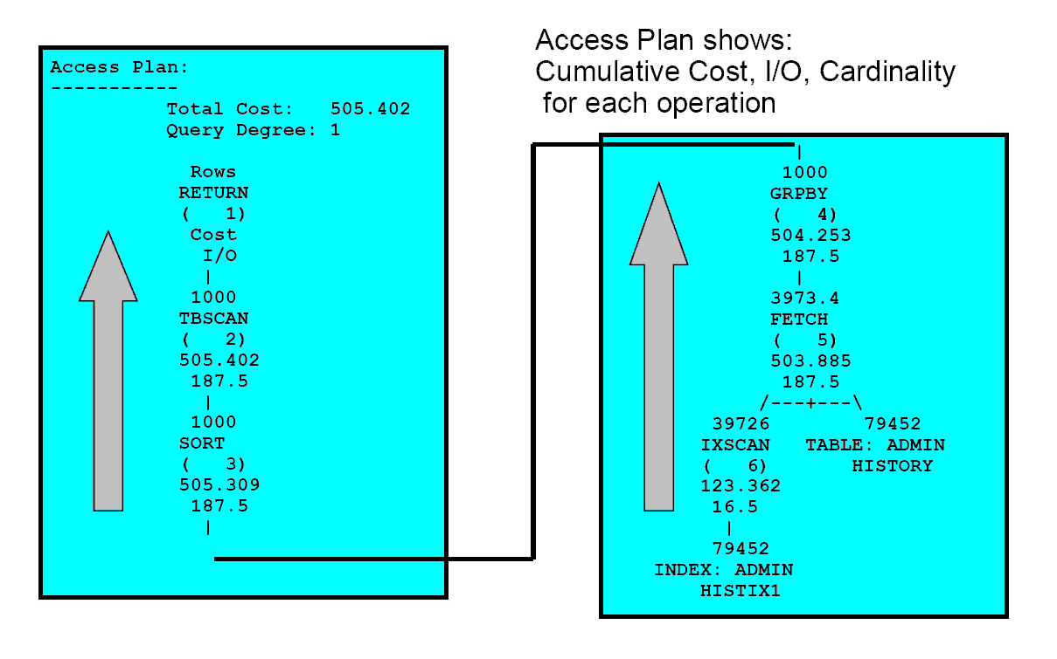
DB2 的执行计划(db2exfmt的输出)
Notes:
Warehouse tasks
Creating a data warehouse involves the following tasks:
Identifying the source data (or operational data) and defining it for use as warehouse sources.
Creating a database to use as the warehouse and defining warehouse targets.
Defining a subject area for groups of processes that you will define in your warehouse.
Specifying how to move and transform the source data into its format for the warehouse database by defining steps in the processes.
Testing the steps that you define and scheduling them to run automatically.
Administering the warehouse by defining security and monitoring database usage using the Work in Progress notebook.
If you have DB2 ® Warehouse Manager, creating an information catalog of the data in the warehouse. An information catalog is a database that contains business metadata. Business metadata helps users identify and locate data and information available to them in the organization. Data
Warehouse Metadata can be published to the information catalog. The information catalog can be searched to determine what data is available in the warehouse.
Defining a star schema model for the data in the warehouse. A star schema is a specialized design that consists of multiple dimension tables, which describe aspects of a business, and one fact table, which contains the facts or measurements about the business. For example, for a manufacturing company, some dimension tables are products, markets, and time. The fact table contains transaction information about the products that are ordered in each region by season.

Slide 6
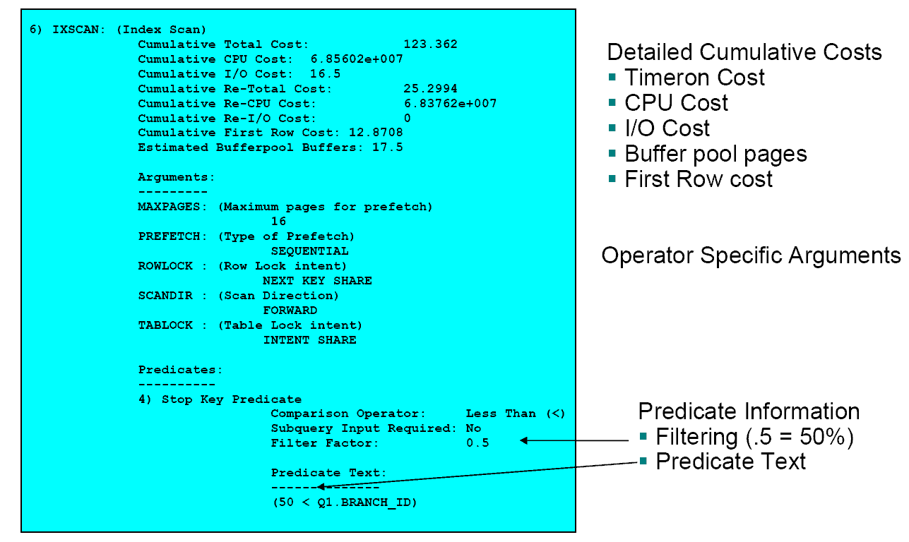
DB2 的执行计划(db2exfmt的输出)
Notes:
Warehouse tasks
Creating a data warehouse involves the following tasks:
Identifying the source data (or operational data) and defining it for use as warehouse sources.
Creating a database to use as the warehouse and defining warehouse targets.
Defining a subject area for groups of processes that you will define in your warehouse.
Specifying how to move and transform the source data into its format for the warehouse database by defining steps in the processes.
Testing the steps that you define and scheduling them to run automatically.
Administering the warehouse by defining security and monitoring database usage using the Work in Progress notebook.
If you have DB2 ® Warehouse Manager, creating an information catalog of the data in the warehouse. An information catalog is a database that contains business metadata. Business metadata helps users identify and locate data and information available to them in the organization. Data
Warehouse Metadata can be published to the information catalog. The information catalog can be searched to determine what data is available in the warehouse.
Defining a star schema model for the data in the warehouse. A star schema is a specialized design that consists of multiple dimension tables, which describe aspects of a business, and one fact table, which contains the facts or measurements about the business. For example, for a manufacturing company, some dimension tables are products, markets, and time. The fact table contains transaction information about the products that are ordered in each region by season.

Slide 7
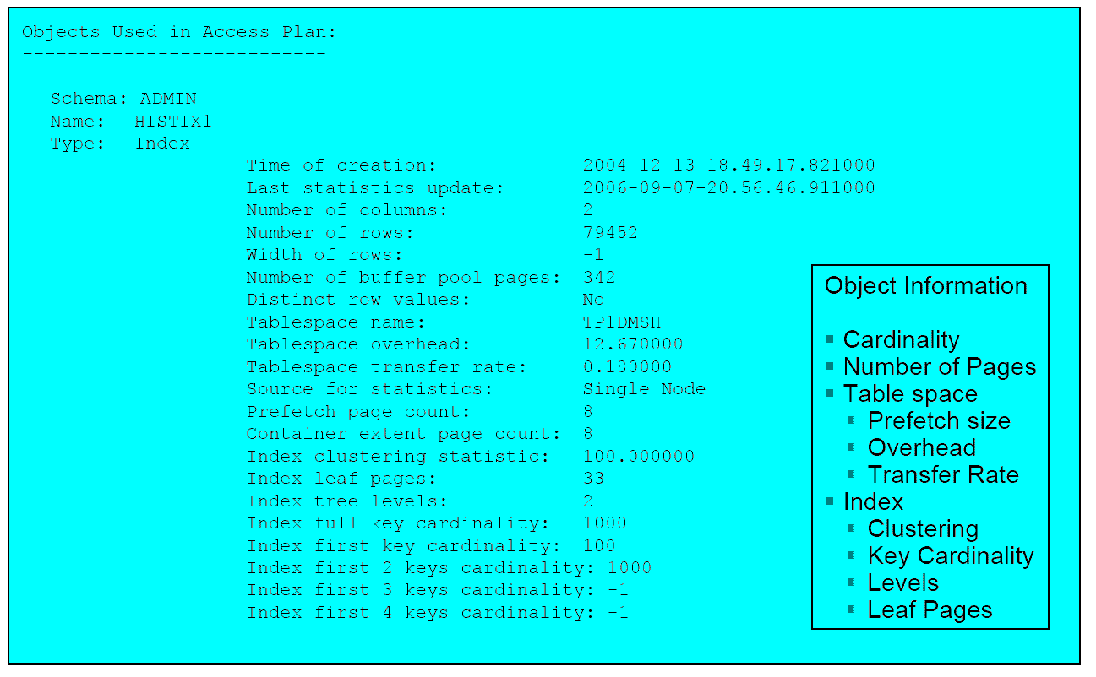
DB2 的执行计划(db2exfmt的输出)
Notes:
Warehouse tasks
Creating a data warehouse involves the following tasks:
Identifying the source data (or operational data) and defining it for use as warehouse sources.
Creating a database to use as the warehouse and defining warehouse targets.
Defining a subject area for groups of processes that you will define in your warehouse.
Specifying how to move and transform the source data into its format for the warehouse database by defining steps in the processes.
Testing the steps that you define and scheduling them to run automatically.
Administering the warehouse by defining security and monitoring database usage using the Work in Progress notebook.
If you have DB2 ® Warehouse Manager, creating an information catalog of the data in the warehouse. An information catalog is a database that contains business metadata. Business metadata helps users identify and locate data and information available to them in the organization. Data
Warehouse Metadata can be published to the information catalog. The information catalog can be searched to determine what data is available in the warehouse.
Defining a star schema model for the data in the warehouse. A star schema is a specialized design that consists of multiple dimension tables, which describe aspects of a business, and one fact table, which contains the facts or measurements about the business. For example, for a manufacturing company, some dimension tables are products, markets, and time. The fact table contains transaction information about the products that are ordered in each region by season.

Slide 8
DB2 的执行计划
请参考实验材料中：
Hornibrook's lecture on explain.zip
Notes:
Warehouse tasks
Creating a data warehouse involves the following tasks:
Identifying the source data (or operational data) and defining it for use as warehouse sources.
Creating a database to use as the warehouse and defining warehouse targets.
Defining a subject area for groups of processes that you will define in your warehouse.
Specifying how to move and transform the source data into its format for the warehouse database by defining steps in the processes.
Testing the steps that you define and scheduling them to run automatically.
Administering the warehouse by defining security and monitoring database usage using the Work in Progress notebook.
If you have DB2 ® Warehouse Manager, creating an information catalog of the data in the warehouse. An information catalog is a database that contains business metadata. Business metadata helps users identify and locate data and information available to them in the organization. Data
Warehouse Metadata can be published to the information catalog. The information catalog can be searched to determine what data is available in the warehouse.
Defining a star schema model for the data in the warehouse. A star schema is a specialized design that consists of multiple dimension tables, which describe aspects of a business, and one fact table, which contains the facts or measurements about the business. For example, for a manufacturing company, some dimension tables are products, markets, and time. The fact table contains transaction information about the products that are ordered in each region by season.

Slide 9
调优过程示例(Lab 3-1)
问题描述
问题分析
问题解决
其它考虑
Notes:
Warehouse tasks
Creating a data warehouse involves the following tasks:
Identifying the source data (or operational data) and defining it for use as warehouse sources.
Creating a database to use as the warehouse and defining warehouse targets.
Defining a subject area for groups of processes that you will define in your warehouse.
Specifying how to move and transform the source data into its format for the warehouse database by defining steps in the processes.
Testing the steps that you define and scheduling them to run automatically.
Administering the warehouse by defining security and monitoring database usage using the Work in Progress notebook.
If you have DB2 ® Warehouse Manager, creating an information catalog of the data in the warehouse. An information catalog is a database that contains business metadata. Business metadata helps users identify and locate data and information available to them in the organization. Data
Warehouse Metadata can be published to the information catalog. The information catalog can be searched to determine what data is available in the warehouse.
Defining a star schema model for the data in the warehouse. A star schema is a specialized design that consists of multiple dimension tables, which describe aspects of a business, and one fact table, which contains the facts or measurements about the business. For example, for a manufacturing company, some dimension tables are products, markets, and time. The fact table contains transaction information about the products that are ordered in each region by season.

Slide 10
问题描述：以下SQL运行速度慢,如何优化？
SELECT
count(*)
FROM
tpcd.part,
tpcd.partsupp,
tpcd.supplier
WHERE
p_partkey = ps_partkey
and s_suppkey = ps_suppkey
and p_size = 30
and ps_suppkey = 9988
Notes:
Warehouse tasks
Creating a data warehouse involves the following tasks:
Identifying the source data (or operational data) and defining it for use as warehouse sources.
Creating a database to use as the warehouse and defining warehouse targets.
Defining a subject area for groups of processes that you will define in your warehouse.
Specifying how to move and transform the source data into its format for the warehouse database by defining steps in the processes.
Testing the steps that you define and scheduling them to run automatically.
Administering the warehouse by defining security and monitoring database usage using the Work in Progress notebook.
If you have DB2 ® Warehouse Manager, creating an information catalog of the data in the warehouse. An information catalog is a database that contains business metadata. Business metadata helps users identify and locate data and information available to them in the organization. Data
Warehouse Metadata can be published to the information catalog. The information catalog can be searched to determine what data is available in the warehouse.
Defining a star schema model for the data in the warehouse. A star schema is a specialized design that consists of multiple dimension tables, which describe aspects of a business, and one fact table, which contains the facts or measurements about the business. For example, for a manufacturing company, some dimension tables are products, markets, and time. The fact table contains transaction information about the products that are ordered in each region by season.

Slide 11
执行计划
Part
p_partkey
p_size
Supplier
ps_suppkey
A
B
Partsupp
ps_partkey
ps_suppkey
200,000 records
10,000 records
800,000 records
Notes:
Warehouse tasks
Creating a data warehouse involves the following tasks:
Identifying the source data (or operational data) and defining it for use as warehouse sources.
Creating a database to use as the warehouse and defining warehouse targets.
Defining a subject area for groups of processes that you will define in your warehouse.
Specifying how to move and transform the source data into its format for the warehouse database by defining steps in the processes.
Testing the steps that you define and scheduling them to run automatically.
Administering the warehouse by defining security and monitoring database usage using the Work in Progress notebook.
If you have DB2 ® Warehouse Manager, creating an information catalog of the data in the warehouse. An information catalog is a database that contains business metadata. Business metadata helps users identify and locate data and information available to them in the organization. Data
Warehouse Metadata can be published to the information catalog. The information catalog can be searched to determine what data is available in the warehouse.
Defining a star schema model for the data in the warehouse. A star schema is a specialized design that consists of multiple dimension tables, which describe aspects of a business, and one fact table, which contains the facts or measurements about the business. For example, for a manufacturing company, some dimension tables are products, markets, and time. The fact table contains transaction information about the products that are ordered in each region by season.

Slide 12
优化后的执行计划
Part
p_partkey
p_size
Supplier
ps_suppkey
B
A
Partsupp
ps_partkey
ps_suppkey
200,000 records
10,000 records
800,000 records
Notes:
Warehouse tasks
Creating a data warehouse involves the following tasks:
Identifying the source data (or operational data) and defining it for use as warehouse sources.
Creating a database to use as the warehouse and defining warehouse targets.
Defining a subject area for groups of processes that you will define in your warehouse.
Specifying how to move and transform the source data into its format for the warehouse database by defining steps in the processes.
Testing the steps that you define and scheduling them to run automatically.
Administering the warehouse by defining security and monitoring database usage using the Work in Progress notebook.
If you have DB2 ® Warehouse Manager, creating an information catalog of the data in the warehouse. An information catalog is a database that contains business metadata. Business metadata helps users identify and locate data and information available to them in the organization. Data
Warehouse Metadata can be published to the information catalog. The information catalog can be searched to determine what data is available in the warehouse.
Defining a star schema model for the data in the warehouse. A star schema is a specialized design that consists of multiple dimension tables, which describe aspects of a business, and one fact table, which contains the facts or measurements about the business. For example, for a manufacturing company, some dimension tables are products, markets, and time. The fact table contains transaction information about the products that are ordered in each region by season.

Slide 13
议程
Day 1:
Explain工具
调优过程示例(Lab 3-1)
break
DB2的复杂SQL实践
  Lab(Lab3-2-SQL)
Day 2:
DB2的优化器
  Lab(Lab3-3-index,Lab3-3-Join,Lab3-3-stats)
break
其它DB2的优化技术
  Lab(Lab3-4-Other)

Slide 14
DB2的复杂SQL
一些基本的建议
Read & Select (10分钟)
Pivot (表的转置)(20分钟)
数据的合并(15分钟)
删除重复行(10分钟)
break(10分钟)
关于流水号(10分钟)
订单处理(10分钟)
递归(15分钟)
Merge(合并)(10分钟)
计算层级(10分钟)

Slide 15
优化SELECT语句
仅指定需要的列。尽管避免SELECT *，因为会导致不必要的处理和返回不需要的列。
通过谓词限定结果集
合理使用FOR READ ONLY, FOR UPDATE
尽可能避免数字数据类型转换。当比较值时，使用有相同数据类型的项可能更有效。如果需要转换，则可能由于精度受限制使结果不准确，并且由于运行时转换而使性能降低。 如果可能的话，使用下列数据类型：
对于较短的列，尽量使用字符而不是可变字符
尽量使用整数，而不是浮点数或小数
尽量使用日期时间，而不是字符
尽量使用数字，而不是字符
要减小排序操作发生的可能性，省略诸如 DISTINCT 或 ORDER BY 的子句或操作（如果这种操作不是必需的话）。

Slide 16
优化多表关联SELECT语句
在连接谓词中的列上定义索引，可以更有效地处理连接。索引也会改善 UPDATE 和 DELETE 语句的性能，这些语句包含访问几个表的 SELECT 语句。
如果可能的话，避免将表达式或 OR 子句与连接谓词一起使用，因为数据库管理器不能使用某些连接技术。因此，可能未选择最有效的连接方法。
在一个分区数据库环境中，如果可能的话，确保在连接列上对已连接的两个表进行了分区。

Slide 17
DB2的复杂SQL
Read & Select
Pivot (表的转置)
数据的合并
删除重复行
break
关于流水号
订单处理
递归
Merge(合并)
计算层级

Slide 18
Read & Select：表
EmpID | Salary | Name | DeptID
1 | 10000 | Jones | 100
2 | 12000 | Wang | 200
3 | 11000 | Zhang | 100
4 | 20000 | Smith | 300
5 | 15000 | Kim | 200
6 | 13000 | Chen | 400
7 | 14000 | Jou | 300
8 | 11000 | Yung | 100
9 | 16000 | Hall | 400
10 | 14000 | Zhu | 100
11 | 13000 | Xia | 200

Slide 19
Read & Select: 问题(5分钟准备)
给部门ID=100的员工加薪5%
A:用游标实现
B:用单个SQL实现

Slide 20
Read & Select：实现1
DECLARE empcur CURSOR FOR
SELECT * FROM emp FOR UPDATE;
OPEN empcur;
emploop: LOOP
FETCH empcur
INTO vempid, vsalary, vname, vdeptid;
IF SQLSTATE = ‘02000’ THEN LEAVE emploop; END IF;
IF deptid = 100 THEN
SET vsalary = vsalary * 1.05;
UPDATE emp SET salary = vsalary
WHERE CURRENT OF empcur;
END IF;
END LOOP emploop;
CLOSE empcur;
Read whole table
Only need few rows

Slide 21
Read & Select：实现2
DECLARE empcur CURSOR FOR
SELECT *
FROM emp
WHERE deptID = 100 FOR UPDATE;
OPEN empcur;
emploop: LOOP
FETCH empcur
INTO vempid, vsalary, vname, vdeptid;
SET vsalary = vsalary * 1.05;
IF SQLSTATE = ‘02000’ THEN LEAVE emploop; END IF;
UPDATE emp SET salary = vsalary
WHERE CURRENT OF empcur;
END LOOP emploop;
CLOSE empcur;
Retrieve all columns
Use only one column

Slide 22
Read & Select：实现3
DECLARE empcur CURSOR FOR
SELECT salary
FROM emp
WHERE deptID = 100 FOR UPDATE;
OPEN empcur;
emploop: LOOP
FETCH empcur INTO vsalary;
SET vsalary = vsalary * 1.05;
IF SQLSTATE = ‘02000’ THEN LEAVE emploop; END IF;
UPDATE emp SET salary = vsalary
WHERE CURRENT OF empcur;
END LOOP emploop;
CLOSE empcur;
Use cursor
Trivial logic

Slide 23
Read & Select：实现4
UPDATE emp
SET salary = salary * 1.05
WHERE deptID = 100;
Tips:
WHERE deptID IN (100, 200)
WHERE deptID
IN (SELECT deptID FROM dept
WHERE deptlocation = ‘Shenzhen’)
SET salary = salary * CASE WHEN name = ‘Zhang’
THEN 1.05 ELSE 1.03
END

Slide 24
DB2的复杂SQL
Read & Select
Pivot (表的转置)
数据的合并
删除重复行
break
关于流水号
订单处理
递归
Merge(合并)
计算层级

Slide 25
Pivot(表的转置)
CREATE TABLE Sales(Year INTEGER,
Quarter INTEGER,
Results INTEGER);
Year | Quarter | Results
2004 | 1 | 20
2004 | 2 | 30
2004 | 3 | 15
2004 | 4 | 10
2005 | 1 | 18
2005 | 2 | 40
2005 | 3 | 12
2005 | 4 | 27

Slide 26
Pivot(表的转置)：问题(5分钟准备)
根据前面的数据，生成以下的数据：
CREATE TABLE SalesAgg(year INTEGER,
q1 INTEGER,
q2 INTEGER,
q3 INTEGER,
q4 INTEGER);
Sales | Q1 | Q2 | Q3 | Q4
2004 | 20 | 30 | 15 | 10
2005 | 18 | 40 | 12 | 27

Slide 27
Pivot(表的转置)：解答
SELECT Year,
MAX(CASE WHEN Quarter = 1
THEN Results END) AS Q1,
MAX(CASE WHEN Quarter = 2
THEN Results END) AS Q2,
MAX(CASE WHEN Quarter = 3
THEN Results END) AS Q3,
MAX(CASE WHEN Quarter = 4
THEN Results END) AS Q4
FROM Sales
GROUP BY Year
Tip:
Use MAX() because it is supported for all comparable types
including strings

Slide 28
Pivot(表的转置)：解答
Access Plan:
-----------
RETURN
( 1)
|
GRPBY
( 2)
|
FETCH
( 3)
/----+---\
IXSCAN TABLE: SALES
( 4)
|
INDEX: SALESIDX

Slide 29
Pivot(表的转置)：问题2(5分钟准备)
如果把问题反一下？
SalesAggr
Sales | Q1 | Q2 | Q3 | Q4
2004 | 20 | 30 | 15 | 10
2005 | 18 | 40 | 12 | 27
Sales
Year | Quarter | Results
2004 | 1 | 20
2004 | 2 | 30
2004 | 3 | 15
2004 | 4 | 10
2005 | 1 | 18
2005 | 2 | 40
2005 | 3 | 12
2005 | 4 | 27

Slide 30
Pivot(表的转置)：问题2的解答
SELECT Year, Quarter, Results
FROM SalesAgg AS S,
LATERAL(VALUES(1, S.q1),
(2, S.q2),
(3, S.q3),
(4, S.q4))
AS Q(Quarter, Results);
Tip:
Use LATERAL (or TABLE) to allow correlation of S.q* to the left.

Slide 31
Pivot(表的转置)：问题2的解答
Access Plan:
-----------
RETURN
( 1)
|
NLJOIN
( 2)
/------+-----\
TBSCAN TBSCAN
( 3) ( 4)
| |
TABLE: SALESAGG TABFNC: GENROW

Slide 32
DB2的复杂SQL
Read & Select
Pivot (表的转置)
数据的合并
删除重复行
break
关于流水号
订单处理
递归
Merge(合并)
计算层级

Slide 33
字符串的合并1：表
CREATE TABLE Employee(name VARCHAR(15),
dept VARCHAR(15));
Name | Dept
Miso | Solutions
John | Development
Serge | Solutions
Lee | L3
Mark | ID
Jack | L3
Lily | Quality
Berni | Solutions

Slide 34
字符串的合并1：问题(5分钟准备)
通过SQL，合并上述数据，生成以下的数据
Dept | Names
Solutions | Berni, Miso, Serge
Development | John
L3 | Jack, Lee
ID | Mark
Quality | Lily

Slide 35
字符串的合并1：提示
XML函数的使用
XMLAGG()
  Aggregates XML values into an XML sequence
XMLELEMENT()
  Tags a scalar value and returns XML
  e.g. XMLELEMENT(NAME ‘x’ 5) => <x>5</x>
XMLSERIALIZE()
  Casts an XML value into a string

Slide 36
字符串的合并1：解答
Strip last comma
SELECT Dept,
SUBSTR(Names, 1, LENGTH(names) -1)
FROM
(SELECT
Dept,
REPLACE
(REPLACE
(XMLSERIALIZE
(CONTENT XMLAGG(XMLELEMENT(NAME a, name)
ORDER BY name)
AS VARCHAR(60)), '<A>', ''),
'</A>', ',') AS Names
FROM Employee
GROUP BY Dept) AS X;
Replace end tags with commas
Strip start tags
XML to VARCHAR
Aggregate in order of names
Tag a name to become XML

Slide 37
字符串的合并2：表
CREATE TABLE probabilities( model VARCHAR(10),
event VARCHAR(10),
percent FLOAT);
Model | Event | Percent
Boing 737 | Engine 1 | 0.001
Airbus 320 | Engine 1 | 0.0009
Boing 737 | Engine 2 | 0.001
Airbus 320 | Engine 2 | 0.0009
Airbus 320 | Fin | 0.002
Boing 737 | Fin | 0.0018

Slide 38
字符串的合并2：问题(5分钟准备)
通过SQL，合并上述数据，生成以下的数据
Model | Percent
Boing 737 | 0.000018
Airbus 320 | 0.000018

Slide 39
字符串的合并2：提示,DB2的汇聚函数
a = EXP(LOG(a))
X* Y = EXP(LOG(X * Y))
X * Y = EXP(LOG(X) + LOG(Y))
PROD(X_{i})_{i=1..n} = EXP(SUM(LOG(X_{i})_{i=1..n})

Slide 40
字符串的合并2：答案
SELECT
model,
DEC(EXP(SUM(LOG(percent))), 8, 7) AS percent
FROM probabilities
WHERE event IN (‘Engine 1’, ‘Fin’)
GROUP BY model

Slide 41
DB2的复杂SQL
Read & Select
Pivot (表的转置)
数据的合并
删除重复行
break
关于流水号
订单处理
递归
Merge(合并)
计算层级

Slide 42
删除重复行：表
CREATE TABLE Inventory(Item INTEGER,
Quantity INTEGER,
InvDate DATE);
CREATE UNIQUE INDEX InvIdx
ON Inventory(Item ASC, InvDate DESC);

Slide 43
删除重复行：表
Item | Quantity | InvDate
1 | 30 | 04 Oct 2003
1 | 25 | 01 Nov 2003
2 | 100 | 01 Nov 2003
3 | 4 | 04 Oct 2003
3 | 8 | 01 Nov 2003
3 | 6 | 18 Dec 2003
4 | 12 | 04 Oct 2003
4 | 0 | 01 Nov 2003
5 | 28 | 18 Dec 2003
6 | 1 | 18 Dec 2003

Slide 44
删除重复行：问题(5分钟准备)
通过SQL，生成以下的数据
Item | Quantity | InvDate
1 | 25 | 01 Nov 2003
2 | 100 | 01 Nov 2003
3 | 6 | 18 Dec 2003
4 | 0 | 01 Nov 2003
5 | 28 | 18 Dec 2003
6 | 1 | 18 Dec 2003

Slide 45
删除重复行：解答1(传统SQL)
DELETE FROM Inventory AS D
WHERE (Item, InvDate)
NOT IN (SELECT Item, InvDate
FROM Inventory I
WHERE D.Item = I.Item
ORDER BY InvDate DESC
FETCH FIRST ROW ONLY);

Slide 46
删除重复行：解答2(使用OLAP函数)
Using OLAP
DELETE FROM
(SELECT row_number()
OVER(PARTITION BY Item
ORDER BY InvDate DESC) AS rn
FROM Inventory)
WHERE rn > 1;
Tip:
Remove ORDER BY clause if it doesn’t matter which duplicates get eliminated.

Slide 47
移动重复行
将重复的记录从一张表移到另一张表
CREATE TABLE Archive LIKE Inventory;
WITH del(Item, Quantity, InvDate)
AS (SELECT Item, Quantity, InvDate
FROM OLD TABLE
(DELETE FROM
(SELECT Item, Quantity, InvDate,
row_number()
OVER(PARTITION BY Item
ORDER BY InvDate DESC) AS rn
FROM Inventory) WHERE rn > 1)),
ins(x) AS (SELECT 1
FROM NEW TABLE(INSERT INTO Archive
SELECT * FROM del))
SELECT COUNT(1) FROM ins;

Slide 48
DB2的复杂SQL
Read & Select
Pivot (表的转置)
数据的合并
删除重复行
break
关于流水号
订单处理
递归
Merge(合并)
计算层级

Slide 49
流水号的处理：问题(5分钟考虑如何优化)
“提交订单，并返回订单号"
    获取下一个订单号
    SELECT nextnum FROM ordermeta; 1 I/O, S 共享锁
    将订单号+1
    UPDATE ordermeta 1 I/O
    SET nextnum = nextnum + 1; S->X
    订单处理，插入新的订单记录
    INSERT INTO orders VALUES(nextnum, ...)
    1 I/O
    返回订单编号
  Deadlock, 3 SQL Stmts, 3 I/O, single row

Slide 50
流水号的处理：优化方案1
使用 SEQUENCE/IDENTITY
INSERT INTO order
VALUES(NEXT VALUE FOR orderseq, ...);
SET ordernum = PREVIOUS VALUE FOR orderseq;
  No Deadlock, 2 SQL statements, 1 I/O,
  single row only

Slide 51
流水号的处理：优化方案2
Use SELECT FROM INSERT
SELECT ordernum INTO :ordernum
FROM NEW TABLE(INSERT INTO orders
VALUES(NEXT VALUE FOR orderseq,
...));
  No Deadlock, 1 I/O,1 SQL Stmt, set oriented

Slide 52
DB2的复杂SQL
Read & Select
Pivot (表的转置)
数据的合并
删除重复行
break
关于流水号
订单处理
递归
Merge(合并)
计算层级

Slide 53
订单的处理：问题1(2分钟考虑如何优化)
删除最老的订单，并返回订单号
    Retrieve "oldest" row in queue
    SELECT ordernum, ... INTO :ordernum 1I/O, S
    FROM orders ORDER BY ordernum
    FETCH FIRST ROW ONLY;
    Delete the row
    DELETE FROM order 1 I/O, S->X
    WHERE :ordernum = ordernum;
  Deadlock, 2 SQL Stmts, single row (or IN list)

Slide 54
订单的处理：解答
删除最老的订单，并返回订单号
SELECT ordernum, ... INTO :ordernum, ...
FROM OLD TABLE(DELETE
FROM (SELECT * FROM orders
ORDER BY ordernum
FETCH FIRST ROW ONLY));
  no Deadlock, 1 I/O, set oriented

Slide 55
订单的处理：问题2(表), 2分钟考虑
Ordernum | AgentID
1031 | 15
1032 | 7
1033 | 20
1034 | NULL
1035 | NULL
1036 | NULL
1037 | NULL
1.找到AgentID为空(无人处理)的订单号最小的订单，将AgentID赋值；
2.对订单进行处理(时间较长);
3.处理完毕，将该订单从订单表中删除

Slide 56
订单的处理：问题2(解答)
SET vthisorder =
(SELECT ordernum
FROM OLD TABLE(UPDATE (SELECT ordernum,
status
FROM orders
WHERE agentid IS NULL
ORDER BY ordernum
FETCH FIRST ROW ONLY)
AS U
SET agentid = vagentid));
COMMIT;
…; -- Long processing
DELETE FROM orders WHERE ordernum = vthisorder;
COMMIT;

Slide 57
DB2的复杂SQL
Read & Select
Pivot (表的转置)
数据的合并
删除重复行
break
关于流水号
订单处理
递归
Merge(合并)
计算层级

Slide 58
递归：表
DDL
CREATE TABLE Sales(day VARCHAR(10),
date DATE,
amount INTEGER)

Slide 59
递归：表
Day | Date | Amount
Friday | 2006-May-12 | 30
Weekend
Monday | 2006-May-15 | 20
Tuesday | 2006-May-16 | 15
Wednesday | 2006-May-17 | 25
Thursday | 2006-May-18 | 31
Friday | 2006-May-19 | 32
Weekend
Monday | 2006-May-22 | 11
Tuesday | 2006-May-23 | 18

Slide 60
递归：问题(5分钟)
根据上述数据，生成自然周的数据(每天一条记录)
Day | Date | Amount
Friday | 2006-May-12 | 30
Saturday | 2006-May-13 | 0
Sunday | 2006-May-14 | 0
Monday | 2006-May-15 | 20
Tuesday | 2006-May-16 | 15
Wednesday | 2006-May-17 | 25
Thursday | 2006-May-18 | 31
Friday | 2006-May-19 | 32
Saturday | 2006-May-20 | 0
Sunday | 2005-May-21 | 0
Monday | 2006-May-22 | 11
Tuesday | 2006-May-23 | 18

Slide 61
递归：解答
Produce a date range
CREATE FUNCTION dates(start DATE, end DATE)
RETURNS TABLE(dt DATE)
RETURN WITH rec(dt) AS (VALUES (start)
UNION ALL
SELECT dt + 1 DAY FROM rec
WHERE dt < end)
SELECT dt FROM rec;
SELECT DAYNAME(date) AS day, date,
COALESCE(sales, 0) AS sales
FROM TABLE(dates(DATE('2006-05-12'),
DATE('2006-05-23'))) AS dates
LEFT OUTER JOIN sales ON dates.dt = sales.date;

Slide 62
递归: DB2 V9.5对Connect By的支持
CREATE TABLE MY_EMP( EMPID INTEGER NOT NULL PRIMARY KEY,
NAME VARCHAR(10),
SALARY DECIMAL(9, 2),
MGRID INTEGER);
INSERT INTO MY_EMP VALUES ( 1, ’Jones’, 30000, 10);
INSERT INTO MY_EMP VALUES ( 2, ’Hall’, 35000, 10);
INSERT INTO MY_EMP VALUES ( 3, ’Kim’, 40000, 10);
INSERT INTO MY_EMP VALUES ( 4, ’Lindsay’, 38000, 10);
INSERT INTO MY_EMP VALUES ( 5, ’McKeough’, 42000, 11);
INSERT INTO MY_EMP VALUES ( 6, ’Barnes’, 41000, 11);
INSERT INTO MY_EMP VALUES ( 7, ’O’’Neil’, 36000, 12);
INSERT INTO MY_EMP VALUES ( 8, ’Smith’, 34000, 12);
INSERT INTO MY_EMP VALUES ( 9, ’Shoeman’, 33000, 12);
INSERT INTO MY_EMP VALUES (10, ’Monroe’, 50000, 15);
INSERT INTO MY_EMP VALUES (11, ’Zander’, 52000, 16);
INSERT INTO MY_EMP VALUES (12, ’Henry’, 51000, 16);
INSERT INTO MY_EMP VALUES (13, ’Aaron’, 54000, 15);
INSERT INTO MY_EMP VALUES (14, ’Scott’, 53000, 16);
INSERT INTO MY_EMP VALUES (15, ’Mills’, 70000, 17);
INSERT INTO MY_EMP VALUES (16, ’Goyal’, 80000, 17);
INSERT INTO MY_EMP VALUES (17, ’Urbassek’, 95000, NULL);

Slide 63
递归: DB2 V9.5对Connect By的支持
SELECT NAME, LEVEL, SALARY,
CONNECT_BY_ROOT NAME AS ROOT,
SUBSTR(SYS_CONNECT_BY_PATH(NAME, ’:’), 1, 25) AS CHAIN
FROM MY_EMP 7
START WITH NAME = ’Goyal’
CONNECT BY PRIOR EMPID = MGRID 9
ORDER SIBLINGS BY SALARY;

Slide 64
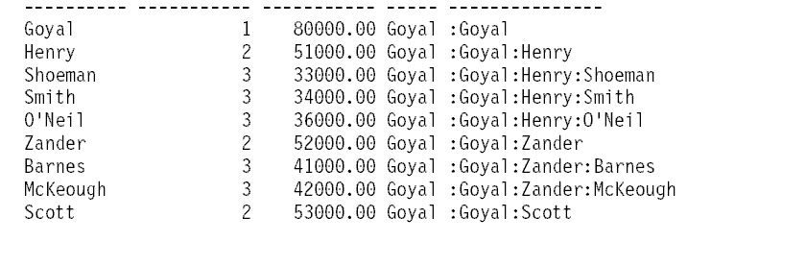
递归: DB2 V9.5对Connect By的支持

Slide 65
DB2的复杂SQL
Read & Select
Pivot (表的转置)
数据的合并
删除重复行
break
关于流水号
订单处理
递归
Merge(合并)
计算层级

Slide 66
Merge语法回顾
MERGE INTO <target> USING <source> ON <match-condition>
{WHEN [NOT] MATCHED [AND <predicate>]
THEN [UPDATE SET ...|DELETE|INSERT VALUES ....|SIGNAL ...]}
[ELSE IGNORE]
<target> is any updatable query
<source> is whatever query you please
<match-condition>
partitions <source> into MATCHED and NOT MATCHED
Each target-row must only be matched once!
WHEN .. [<predicate>]
executes THEN for subset of [not] matched rows.
each row in <source> is processed once in first qualifying
WHEN only

Slide 67
Update From(不用merge)
CREATE TABLE T(pk INT NOT NULL PRIMARY KEY,
c1 INT);
CREATE TABLE S(pk INT NOT NULL PRIMARY KEY,
c1 INT);
Standard pre SQL4
UPDATE T SET c1 = (SELECT c1 FROM S
WHERE S.pk = T.pk)
WHERE pk IN (SELECT pk FROM S);
IBM Informix/MS SQL Server
UPDATE T SET c1 = S.c1 FROM T, S
WHERE T.pk = S.pk;

Slide 68
Update From(用merge)
MERGE INTO T USING S ON T.pk = S.pk
WHEN MATCHED THEN UPDATE SET c1 = S.c1;
RETURN
|
UPDATE
/---+---\
FILTER TABLE: T
|
NLJOIN
/-------+-------\
TBSCAN FETCH
| /----+---\
TABLE: S IXSCAN TABLE: T
|
INDEX: T_PK

Slide 69
Upsert
Standard pre SQL4 (one way of many)
FOR m AS SELECT T.pk tpk, S.pk spk, S.c1
FROM T RIGHT JOIN S ON T.pk = S.pk DO
IF m.tpk IS NULL THEN
INSERT INTO T VALUES(m.spk, m.c1);
ELSE
UPDATE T SET c1 = m.c1 WHERE pk = tpk;
END IF;
END FOR;

Slide 70
Upsert with merge
MERGE INTO T USING S ON T.pk = S.pk
WHEN MATCHED THEN UPDATE SET c1 = S.c1
WHEN NOT MATCHED THEN INSERT VALUES(pk, c1);
RETURN
|
INSERT
/---+---\
TBSCAN TABLE: T
|
TEMP
|
UPDATE
/---+---\
NLJOIN TABLE: T
/------------------+-----------------\
NLJOIN UNION
25.7489 0.00166765
/-------+-------\ /------+-----\
TBSCAN FETCH FILTER FILTER
| /----+---\ | |
TABLE: S IXSCAN TABLE: T TBSCAN TBSCAN
| | |
INDEX: T_PK TABFNC: GENROW TABFNC: GENROW

Slide 71
单条记录 Upsert with merge
MERGE INTO T USING (VALUES(1, 2)) AS S(pk, c1)
ON S.pk = T.pk
WHEN MATCHED THEN UPDATE SET c1 = S.c1
WHEN NOT MATCHED THEN INSERT VALUES (pk, c1)
RETURN
|
INSERT
/------+------\
UPDATE TABLE: T
/------+-------\
NLJOIN TABLE: T
/-------------+-------------\
NLJOIN UNION
/-----+-----\ /------+-----\
TBSCAN TBSCAN FILTER FILTER
| | | |
TABFNC: GENROW TABLE: T TBSCAN TBSCAN
| |
TABFNC: GENROW TABFNC: GENCROW

Slide 72
DB2的复杂SQL
Read & Select
Pivot (表的转置)
数据的合并
删除重复行
break
关于流水号
订单处理
递归
Merge(合并)
计算层级

Slide 73
计算层级：表
CREATE TABLE log(timestamp TIMESTAMP,
event CHAR(3),
data VARCHAR(10));

Slide 74
计算层级：表
Timestamp | Event
2006-03-02 04:12:16.124565 | In
2006-03-02 04:12:19.134514 | In
2006-03-02 04:13:42.424085 | Out
2006-03-02 04:15:31.872452 | In
2006-03-02 04:16:42.004545 | In
2006-03-02 04:17:01.994432 | In
2006-03-02 04:17:23.569474 | Out
2006-03-02 04:22:25.946465 | Out
2006-03-02 04:32:19.543438 | In
2006-03-02 04:33:58.172535 | Out
2006-03-02 04:42:00.836468 | Out
2006-03-02 04:46:51.643544 | Out

Slide 75
计算层级：表
Nesting | Timestamp | Event
> | 2006-03-02 04:12:16.124565 | In
|> | 2006-03-02 04:12:19.134514 | In
|< | 2006-03-02 04:13:42.424085 | Out
|> | 2006-03-02 04:15:31.872452 | In
||> | 2006-03-02 04:16:42.004545 | In
|||> | 2006-03-02 04:17:01.994432 | In
|||< | 2006-03-02 04:17:23.569474 | Out
||< | 2006-03-02 04:22:25.946465 | Out
||> | 2006-03-02 04:32:19.543438 | In
||< | 2006-03-02 04:33:58.172535 | Out
|< | 2006-03-02 04:42:00.836468 | Out
< | 2006-03-02 04:46:51.643544 | Out

Slide 76
计算层级：表
SELECT REPEAT('|',SUM(CASE event
WHEN 'In' THEN 1
WHEN 'Out' THEN -1 END)
OVER (ORDER BY timestamp)
+ CASE event
WHEN 'In' THEN -1
ELSE 0 END)
|| CASE event WHEN 'In' THEN '>'
WHEN 'Out' THEN '<' END
AS nesting,
timestamp,
event
FROM Log
ORDER BY timestamp;

